Slide 1
Chapter 26
Halliday & Resnick’s
Fundamentals of Physics
Jearl Walker
Current and Resistance

Slide 2
26.2: Electric Current:
Although an electric current is a stream of moving charges, not all moving
charges constitute an electric current.
If there is to be an electric current through a given surface, there must be a net flow of charge through that surface. Two examples are given.
1. The free electrons (conduction electrons) in an isolated length of copper wire are in random motion at speeds of the order of 106 m/s. If you pass a hypothetical plane through such a wire, conduction electrons pass through it in both directions at the rate of many billions per second—but there is no net transport of charge and thus no current through the wire.
However, if you connect the ends of the wire to a battery, you slightly bias the flow in one direction, with the result that there now is a net transport of charge and thus an electric current through the wire.
2. The flow of water through a garden hose represents the directed flow of positive
charge (the protons in the water molecules) at a rate of perhaps several million coulombs per second.
There is no net transport of charge, because there is a parallel flow of negative charge (the electrons in the water molecules) of exactly the same amount moving in exactly the same direction.

Slide 3
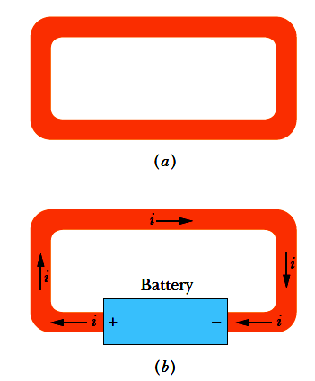
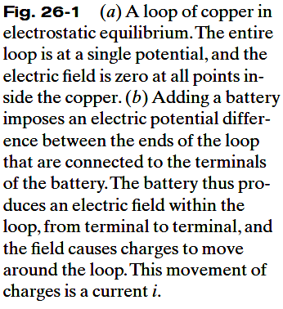
26.2: Electric Current:

Slide 4
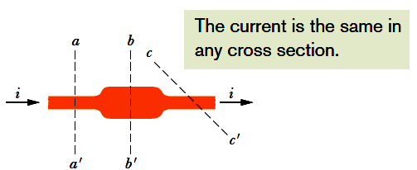
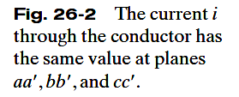


26.2: Electric Current:
The figure shows a section of a conductor, part of a conducting loop in which current has been established. If charge dq passes through a hypothetical plane (such as aa’) in time dt, then the current i through that plane is defined as:
The charge that passes through the plane in a time interval extending from 0 to t is:
Under steady-state conditions, the current is the same for planes aa’, bb’, and cc’ and for all planes that pass completely through the conductor, no matter what their location or orientation.
The SI unit for current is the coulomb per second, or the ampere (A):

Slide 5
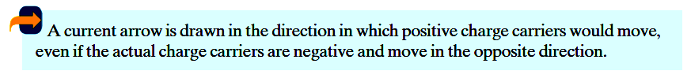
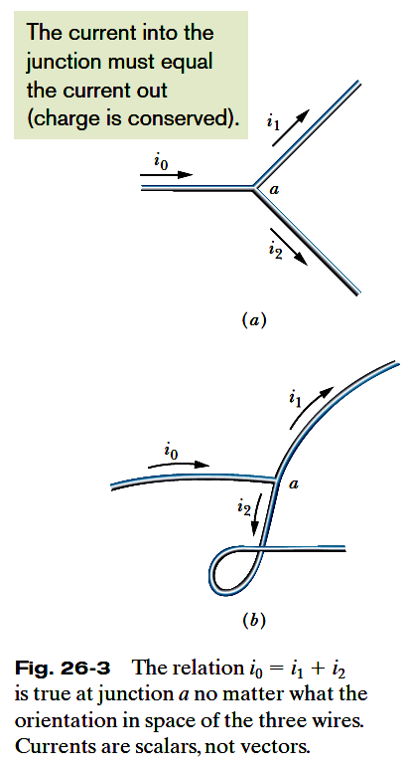
26.2: Electric Current, Conservation of Charge, and Direction of Current:

Slide 6
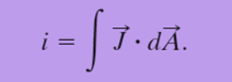
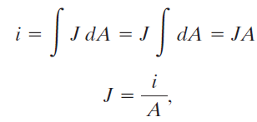
26.3: Current Density:
The magnitude of current density, J, is equal to the current per unit area through any element of cross section. It has the same direction as the velocity of the moving charges if they are positive and the opposite direction if they are negative.
If the current is uniform across the surface and parallel to dA, then J is also uniform
and parallel to dA.
Here, A is the total area of the surface.
The SI unit for current density is the ampere per square meter (A/m²).

Slide 7
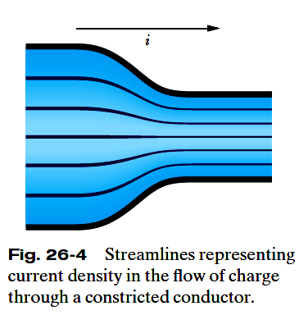
26.3: Current Density:
Figure 26-4 shows how current density can be represented with a similar set of lines, which we can call streamlines.
The current, which is toward the right, makes a transition from the wider conductor at the left to the narrower conductor at the right.
Since charge is conserved during the transition, the amount of charge and thus the amount of current cannot change.
However, the current density changes—it is greater in the narrower conductor.

Slide 8
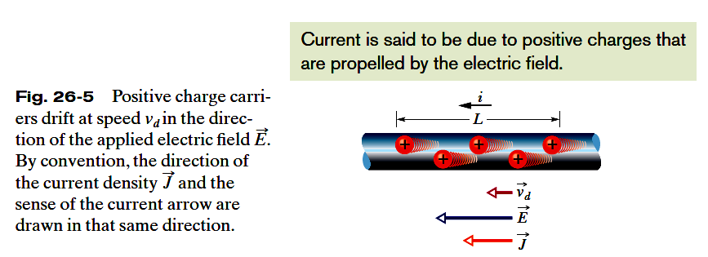




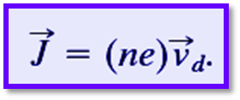
26.3: Current Density, Drift Speed:
When a conductor has a current passing through it, the electrons move randomly, but they tend to drift with a drift speed v_{d} in the direction opposite that of the applied electric field that causes the current. The drift speed is tiny compared with the speeds in the random motion.
In the figure, the equivalent drift of positive charge carriers is in the direction of the applied electric field, E. If we assume that these charge carriers all move with the same drift speed v_{d} and that the current density J is uniform across the wire’s cross-sectional area A, then the number of charge carriers in a length L of the wire is nAL. Here n is the number of carriers per unit volume.
The total charge of the carriers in the length L, each with charge e, is then
The total charge moves through any cross section of the wire in the time interval

Slide 9
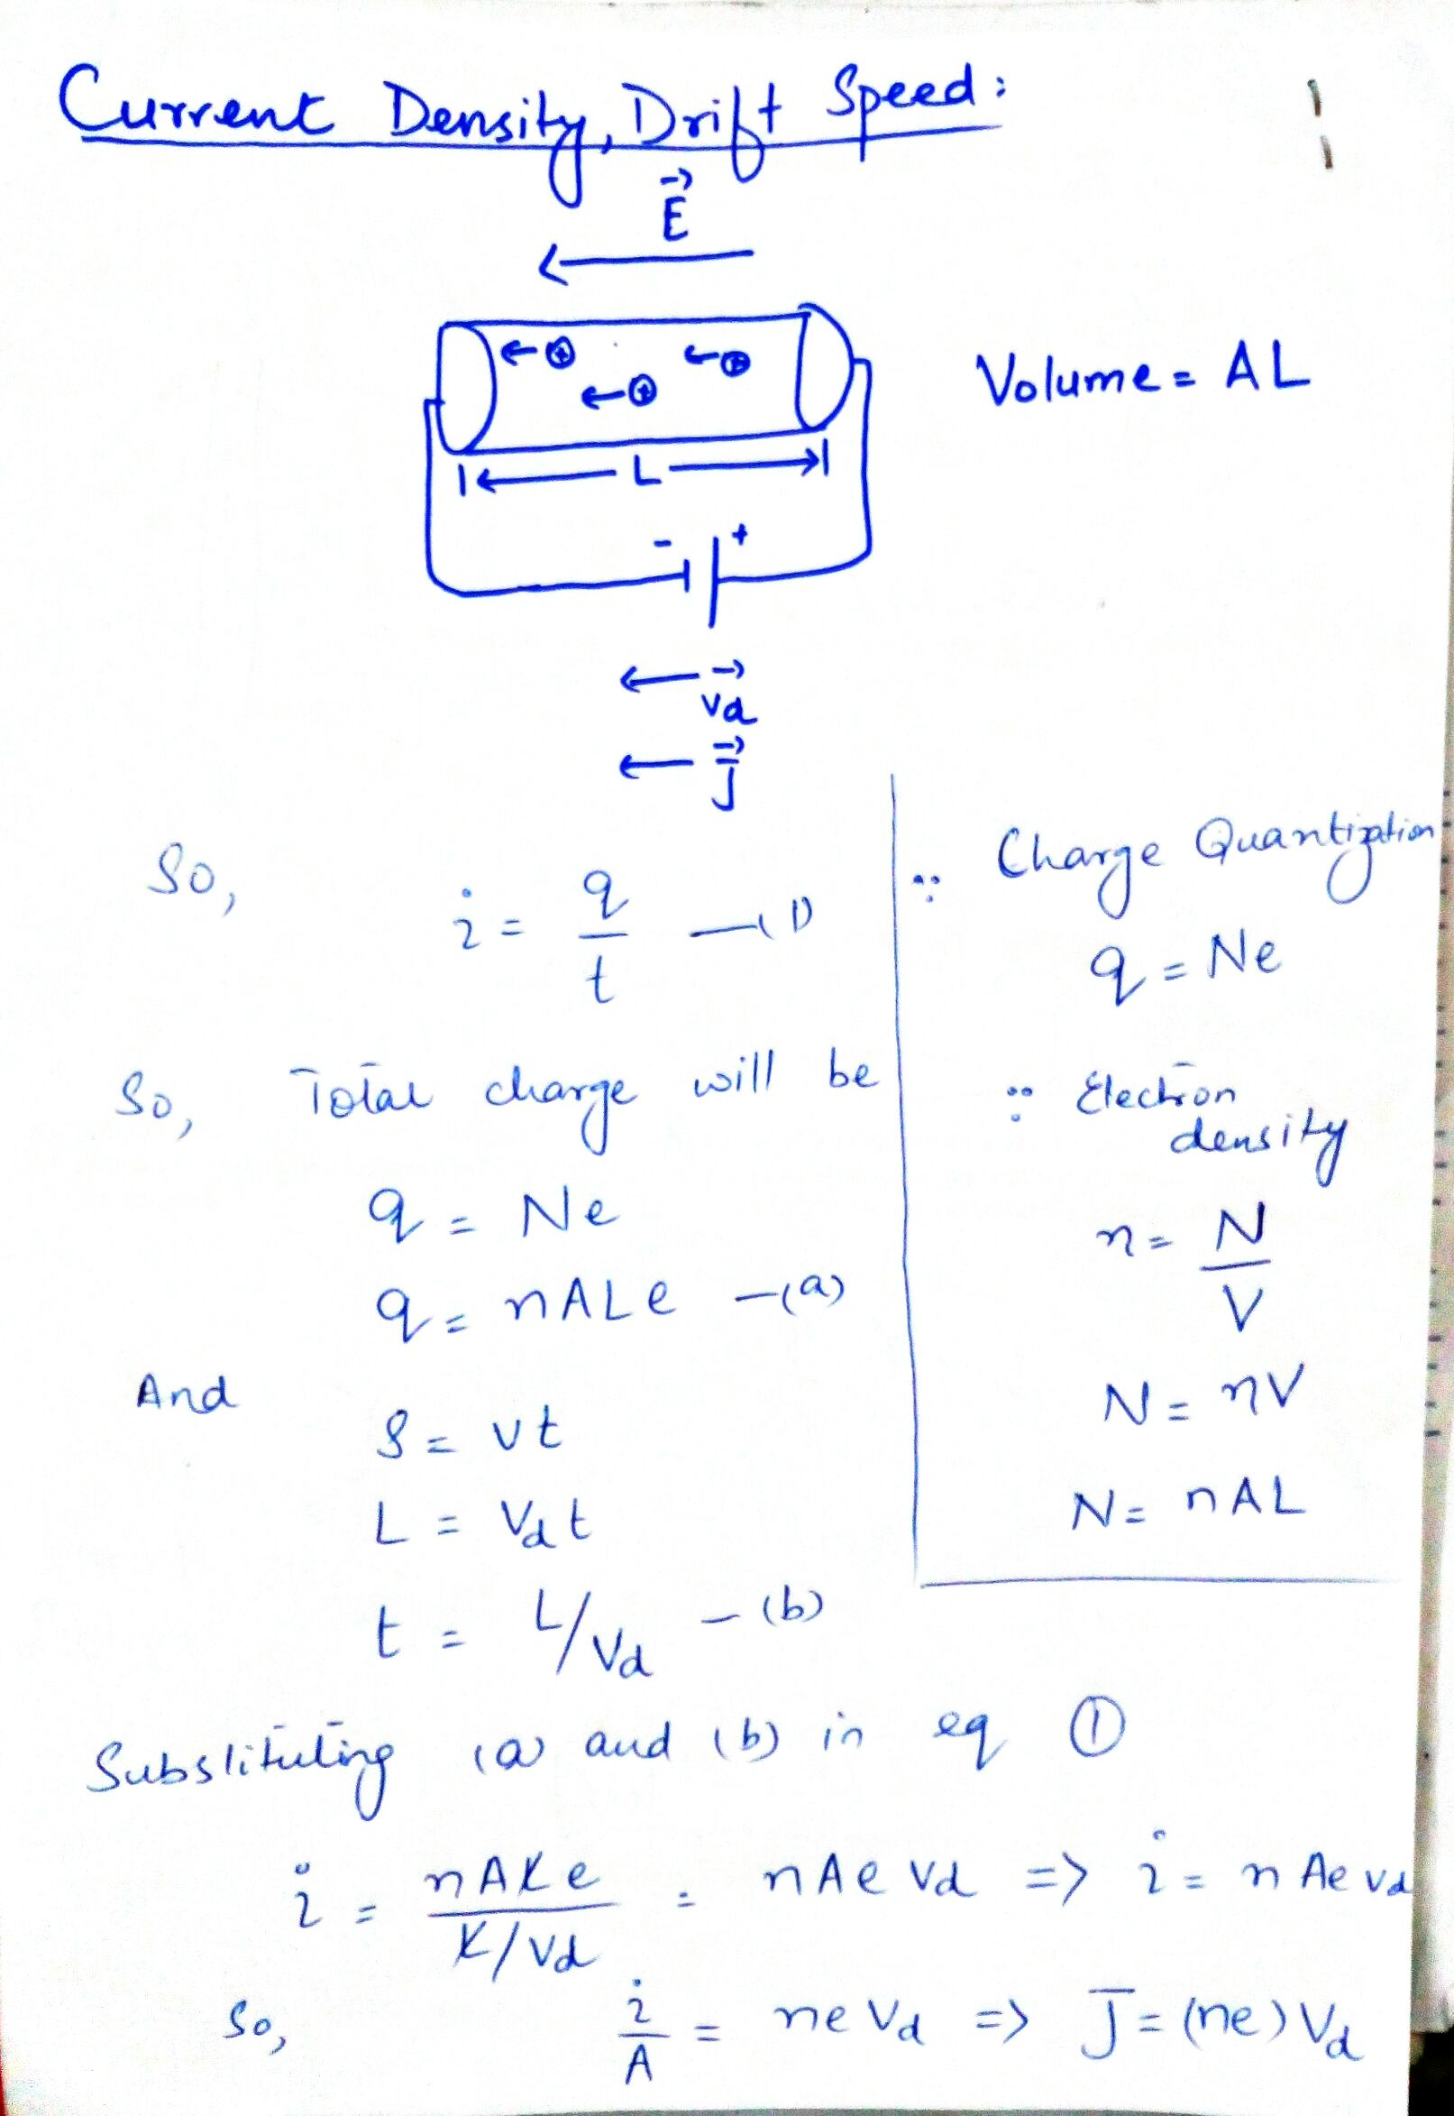

Slide 10
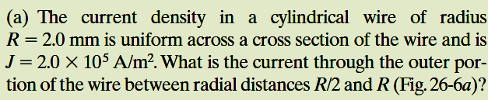
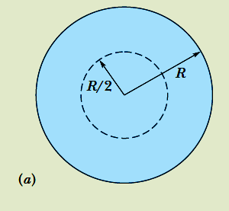
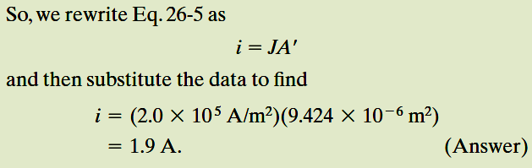
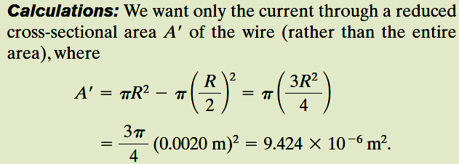
Example, Current Density, Uniform and Nonuniform:

Slide 11
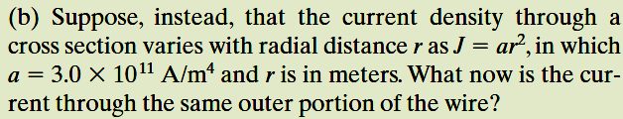
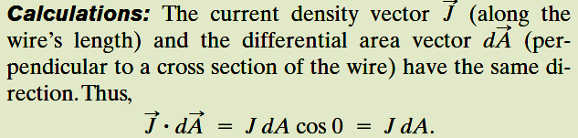
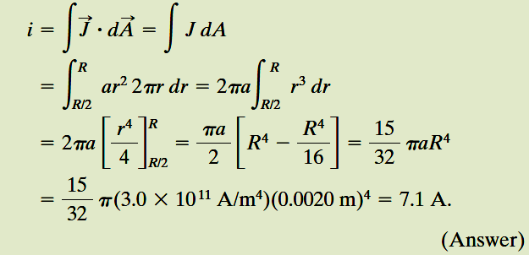
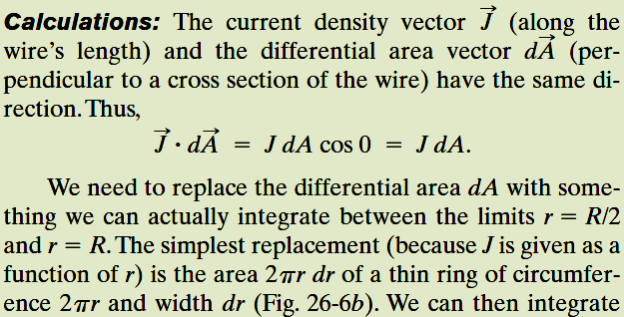
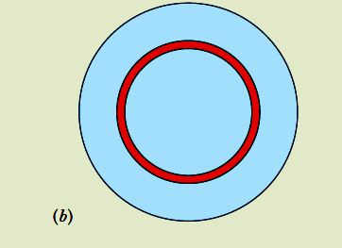
Example, Current Density, Uniform and Nonuniform, cont.:

Slide 12


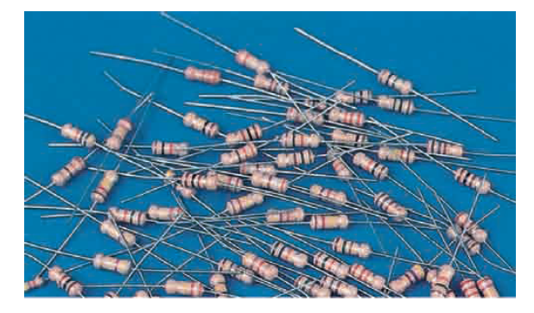
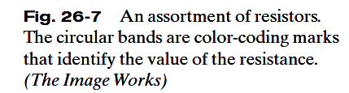
26.4: Resistance and Resistivity:
We determine the resistance between any two points of a conductor by applying a potential difference V between those points and measuring the current i that results. The resistance R is then
The SI unit for resistance that follows from Eq. 26-8 is the volt per ampere. This has a special name, the ohm (symbol Ω):
In a circuit diagram, we represent a resistor and a resistance with the symbol .

Slide 13
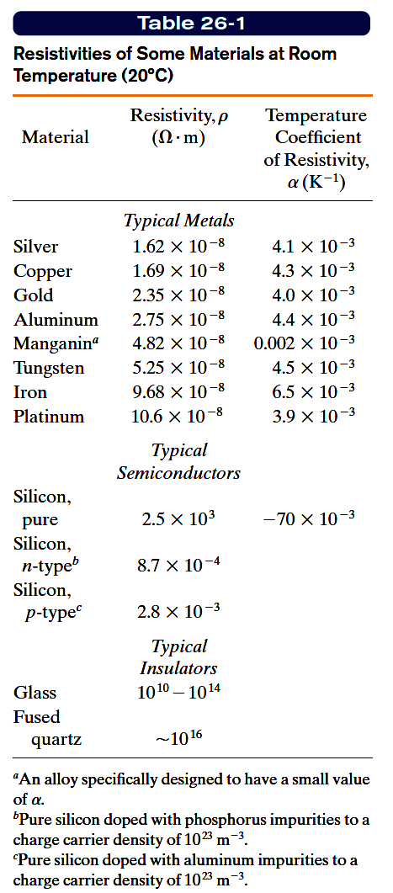




26.4: Resistance and Resistivity:
The resistivity, ρ, of a resistor is defined as:
The SI unit for ρ is Ω.m.
The conductivity σ of a material is the reciprocal of its resistivity:

Slide 14
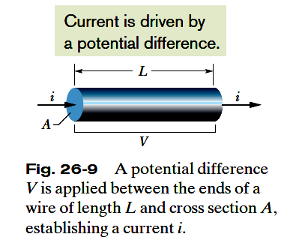



26.4: Resistance and Resistivity, Calculating Resistance from Resistivity:
If the streamlines representing the current density are uniform throughout the wire, the electric field, E, and the current density, J, will be constant for all points within the wire.

Slide 15
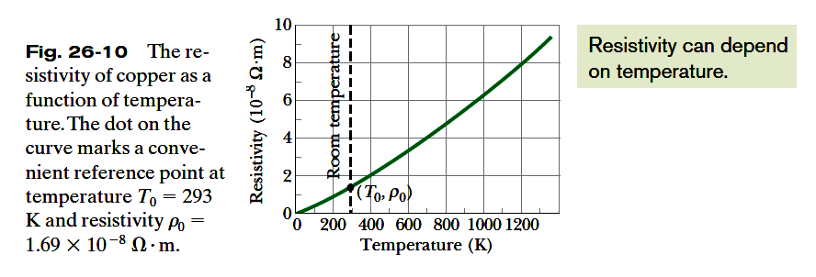
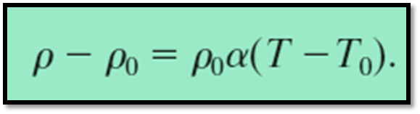
26.4: Resistance and Resistivity, Variation with Temperature:
The relation between temperature and resistivity for copper—and for metals in general—is fairly linear over a rather broad temperature range.
For such linear relations we can write an empirical approximation that is good enough for most engineering purposes:

Slide 16
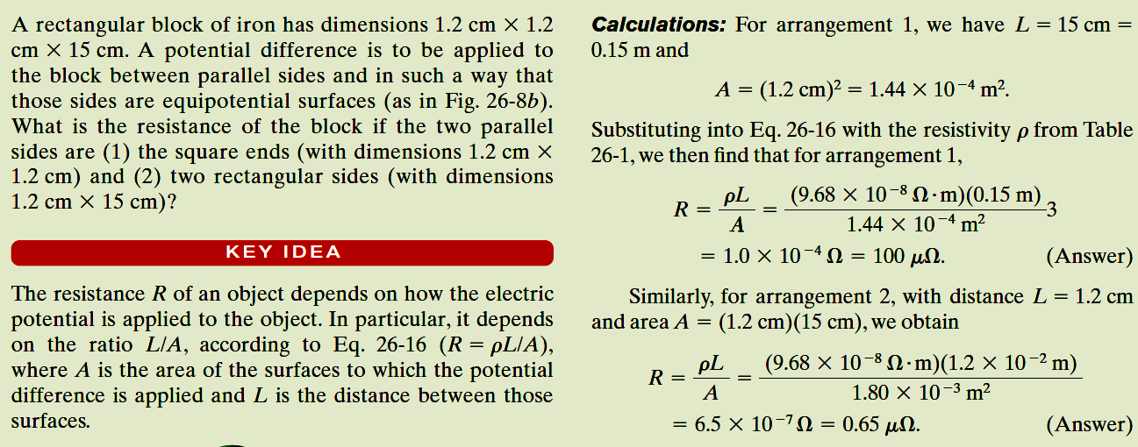
Example, A material has resistivity, a block of the material has a resistance.:

Slide 17

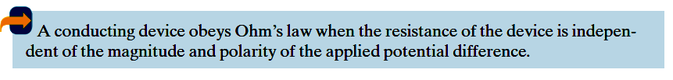
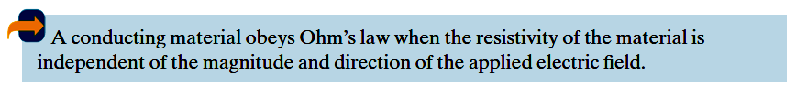
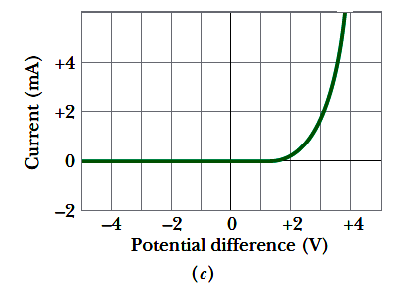
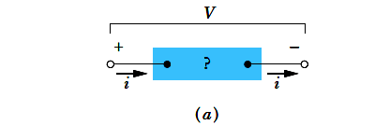
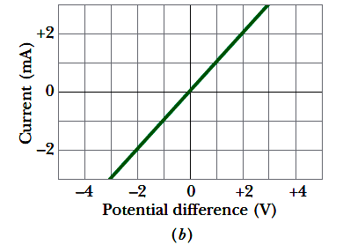
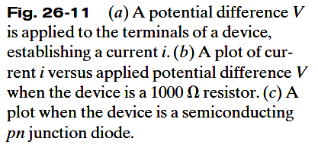
26.5: Ohm’s Law:

Slide 18
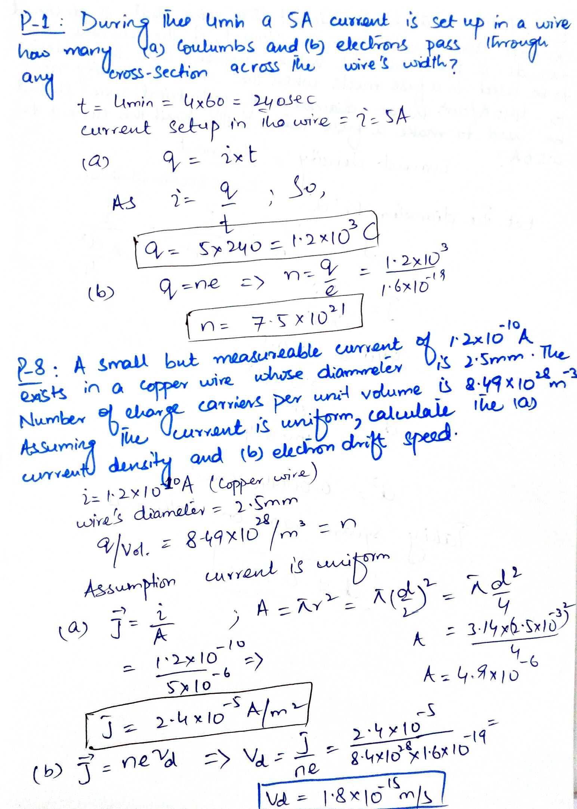

Slide 19
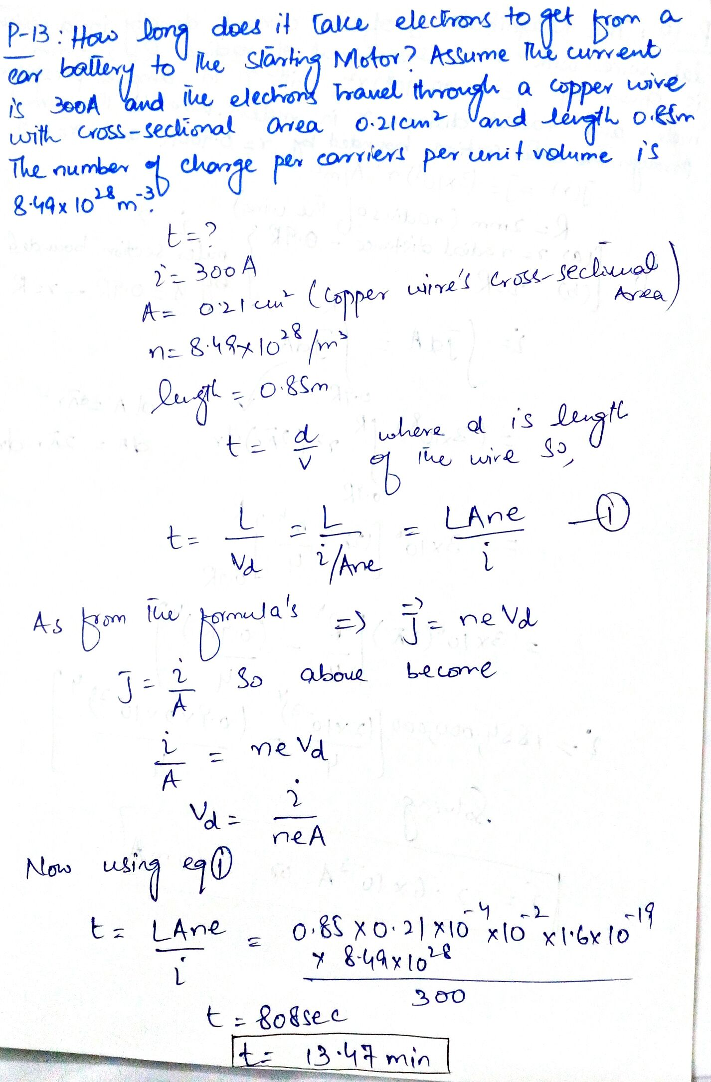

Slide 20
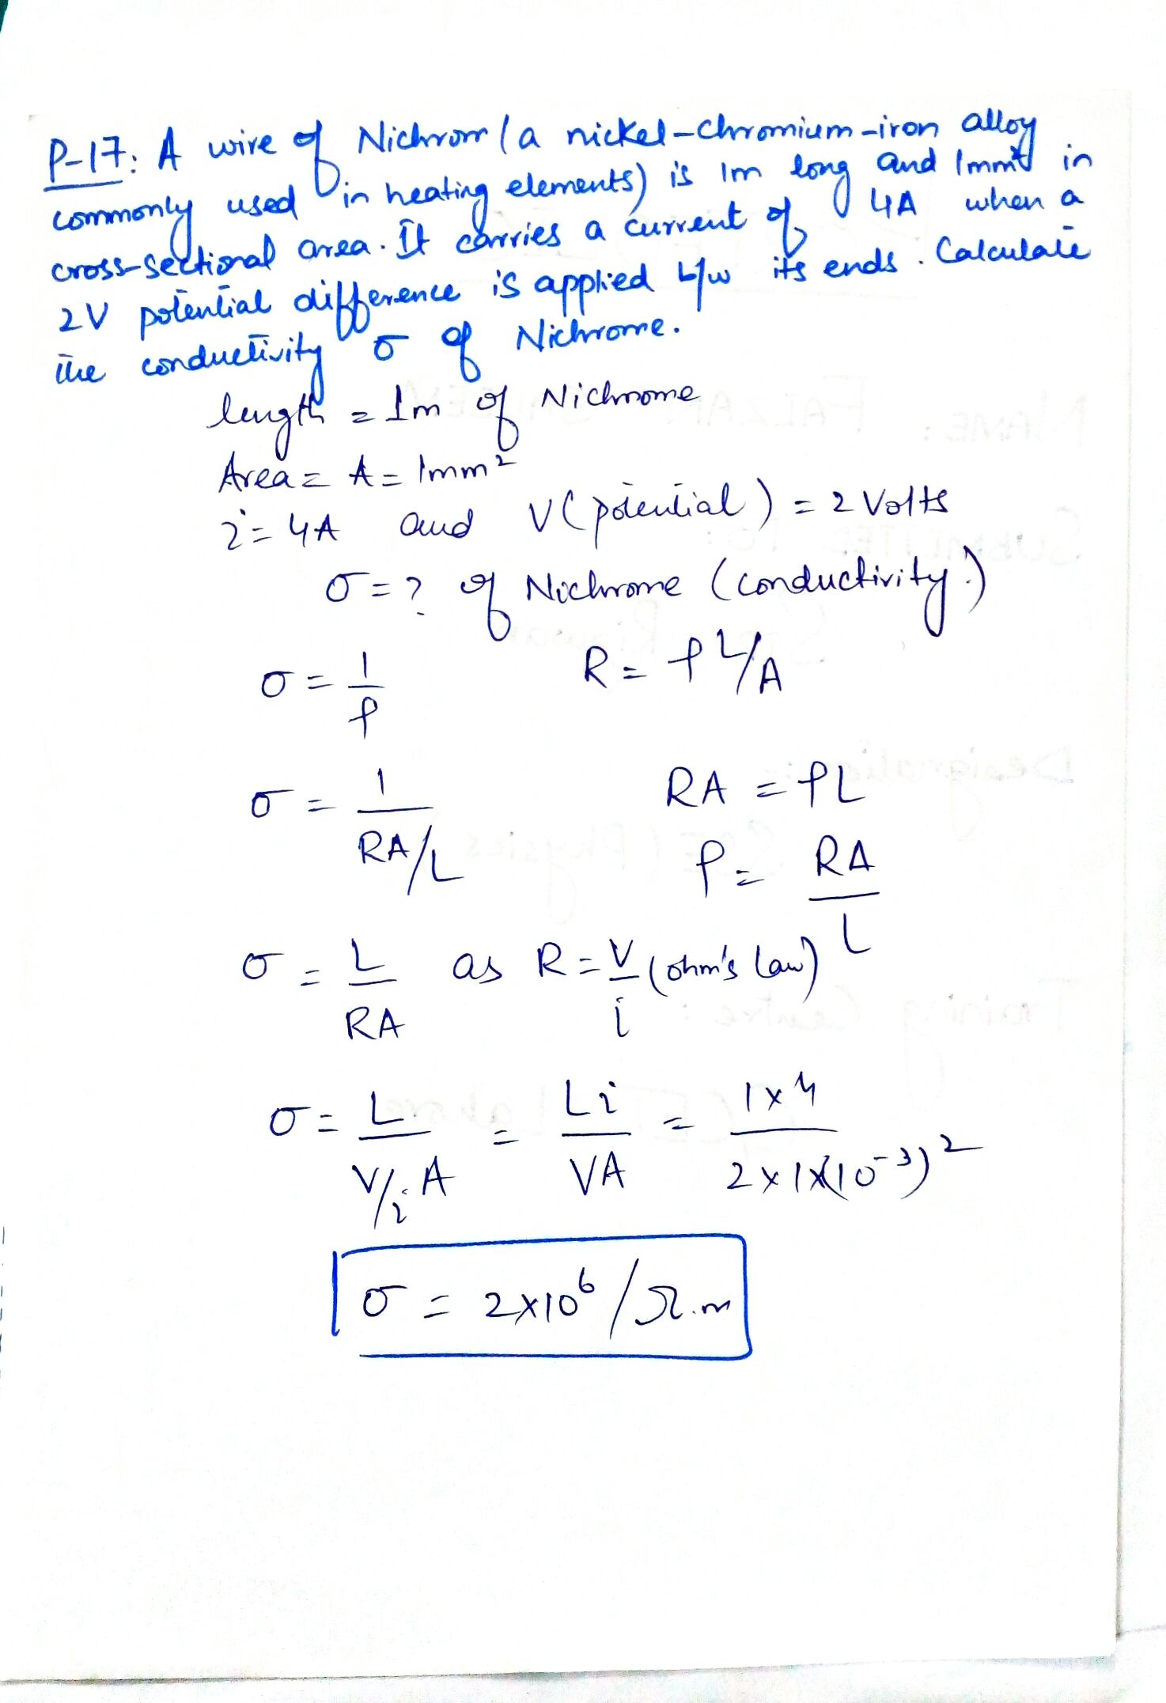

Slide 21
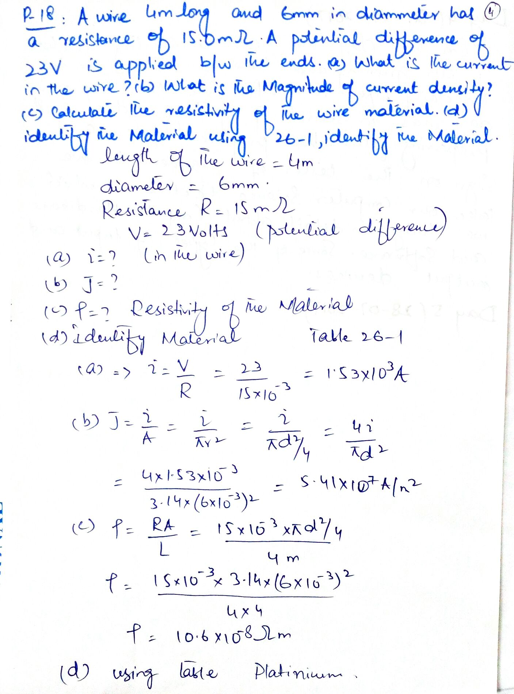

Slide 22
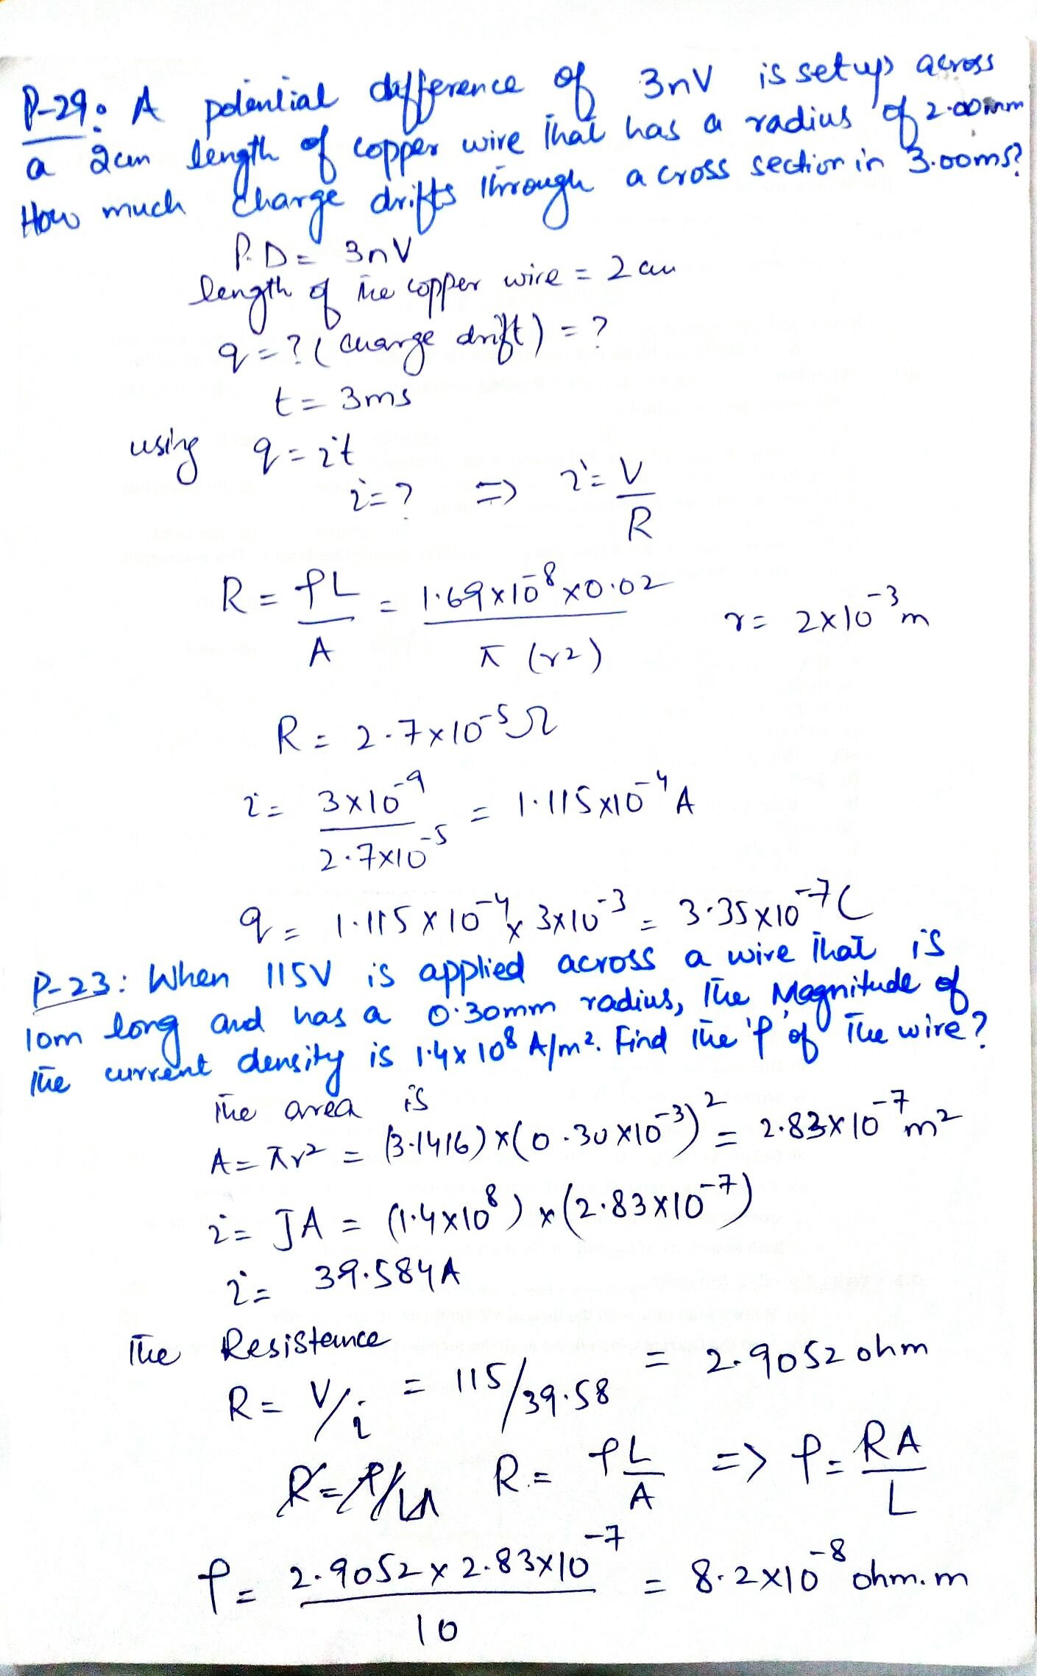

Slide 23
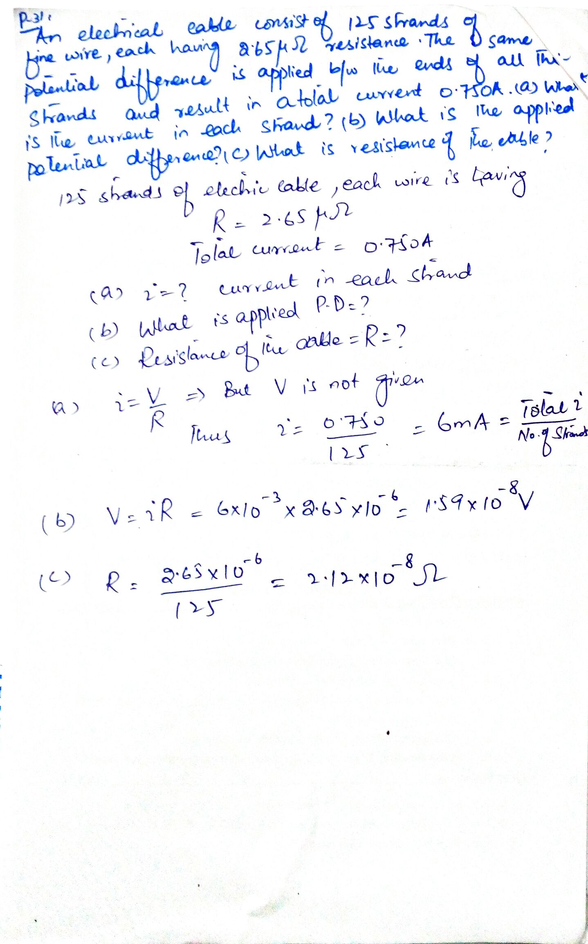

Slide 24
Chapter 26: Current and resistance
Exercise problems:
1, 2, 4, 5, 7, 8, 10, 11, 12, 13, 14, 15, 17, 18, 19, 23, 29, 31, 32
Sample problems:
26.02, 26.04

